Slide 1

2025-26 Final Budget Board of Trustees September 2, 2025

Slide 2
State Budget

Slide 3
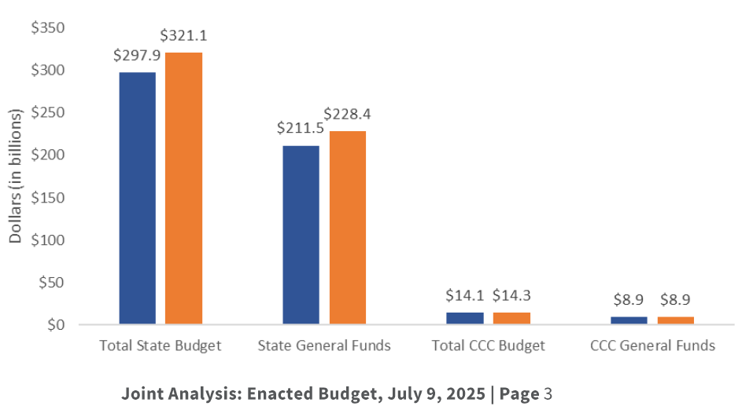
2025-26 State Budget
($23.2B)
($16.9B)
The 2025-26 State Budget reflects total state expenditures of $321.1 billion and general fund expenditures of $228.4 billion. Each category of spending increased nearly 8.0% from the previous year.
- The State Budget addresses a deficit of $12 billion.

Slide 4
2025-26 State Budget
The $321.1 billion State Budget reflects, in part, the use of reserves and special fund transfers as revenue to offset revenue shortfalls that arose after the balanced budget of January 2025. Main causes included:
revenue slowdown since the Governor’s January Budget Proposal;
stock market volatility;
the potential impact of federal tariffs;
significant increases in state costs for certain programs (especially Medi-Cal); and
potential for federal cuts presently under consideration for health and social service programs.
The State Budget addresses its $12 billion deficit through a combination of:
program reductions, borrowing, fund shifts, reserves, and cash deferrals.

Slide 5
State Budget Deficit Reduction Toolbox Solutions
Ongoing and/or One-Time Expenditure Reductions
Use of State Reserve Funds
Budget Stabilization Account (BSA)
Public School System Stabilization Account (PSSSA)
Cash Deferrals
Clawback Unspent Funds from Previous Years’ Allocations
Remove the Longstanding Flexibility of Summer Enrollment Push/Pull Shifts
Apply a Deficit Factor
Borrow money from special funds and label as “Revenue”
e.g., Gas Tax
Fund Shifts
Delay Spending
Shift 2024 Payroll to July (A Reduction on Paper)
And more…

Slide 6
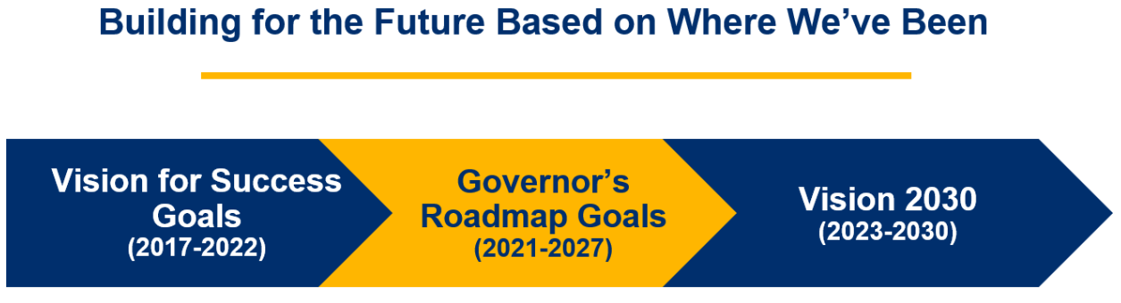

State Budget: Continued Focus on Higher Education
Year 4: Multi-Year Roadmap for Higher Education
The 2025-26 Enacted Budget reflects a continued focus on achieving the goals of the multiyear compacts with the University of California and the California State University, and the multiyear roadmap with the California Community Colleges (CCCs), which outline shared goals to increase access to the UC and CSU, improve student success while advancing equity, increase the affordability of higher education, increase intersegmental collaboration, and support workforce preparedness and high-demand career pipelines.

Slide 7
California Community Colleges

Slide 8
2025-26 State Budget: Focus on CCC Stability–Year 2
($23.2B)
The 2025-26 State Budget focuses on maintaining stability for community colleges for the second year in-a-row in a challenging fiscal environment.
- No core major reductions to programs or services
- Overall, funding is roughly flat compared to FY24.
($16.9B)

Slide 9
2025-26 State Budget — CCC Ongoing Funds
Community Colleges are provided with budget stability for the second year in-a-row, with NO core major reductions and $404 million in ongoing adjustments, including:
$217.4 million for a 2.3% COLA for the Student Centered Funding Formula¹;
$26.8 million for a 2.3% COLA for selected categorical programs;
$140 million to cover enrollment growth of 2.35% over two years ($100 million starting in 2024-25 and $40 million starting in 2025-26)¹;
$10 million to expand the Rising Scholars Network;
$5 million to expand Credit for Prior Learning (CPL);
$3.3 million for adjustments to financial aid administration.
¹To fully fund the SCFF and maintain the level of 2025-26 apportionments, the Budget defers $408.4 million in Proposition 98 General Fund apportionment funding from 2025-26 to 2026-27.

Slide 10
2025-26 State Budget — CCC One-Time Funds
Investments to Support Implementation of the Master Plan for Career Education | Enacted Budget
Student Support Block Grant | $ 60 M
Career Passports Initiative | $ 25 M
Emergency financial aid | $ 20 M
Dreamer Resource Liaisons | $ 15 M
Expand Credit for Prior Learning | $ 15 M
Systemwide Common Cloud Data Platform | $ 12 M
California Healthy School Food Pathway Program | $ 10 M
Emergency Med Tech and Paramedic Pre-apprenticeship Academies | $ 10 M
Reimburse apprenticeship shortfalls from 2022-23 and 2023-24 | $ 6.3 M
Financial aid community outreach | $ 5.1 M
Workforce recovery career education in Los Angeles region | $ 5.0 M
Santa Rose Junior College Fire Academy Tower | $ .13 M

Slide 11
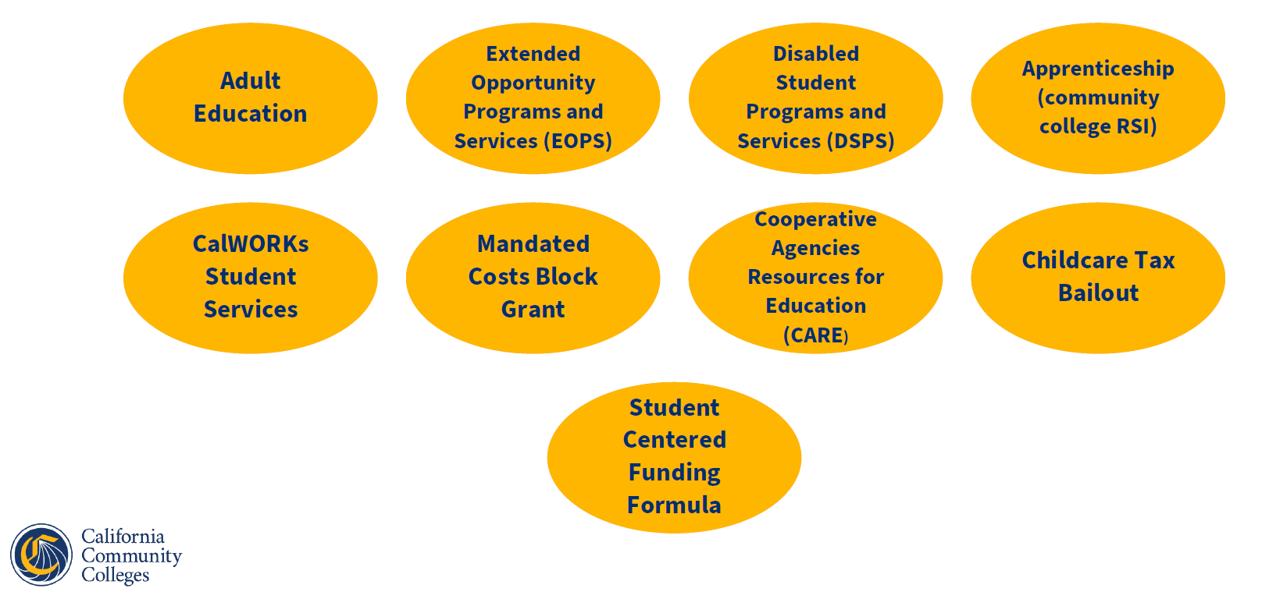
Programs Receiving COLA and/or Adjustments
2.30%
2.30%
2.30%
2.69%
2.30%
.94%
2.30%
2.30%
4.12%
4.53%
40.0%
Financial Aid Administration
Rising Scholars Network

Slide 12

Programs Funded at 2024-2025 Amounts, but No COLA
Student Equity and Achievement Program
Student Success Completion Grant
Strong Workforce Program
Part-time Faculty Health Insurance
Full-time Faculty Hiring
California College Promise (AB 19)
Integrated Technology
NextUp (foster youth program)
Basic Needs Centers
Mathematics, Engineering, Science Achievement (MESA)
Student Mental Health Services
California Apprenticeship Initiative
Institutional Effectiveness Initiative
Part-time Faculty Compensation
Part-time Faculty Office Hours
Economic and Workforce Development
Homeless and Housing Insecurity Program
California Virtual Campus
Calbright College
Nursing Grants
Puente Project
Equal Employment Opportunity Program (-8.02% decrease in available funding)
Student Housing Lease Revenue Bond Payments (-.20% decrease in available funding)
Dreamer Resource Liaisons
Veterans Resource Centers
Classified Employee Summer Assistance Program
Immigrant Legal Services through CDSS
Umoja
AANHPI Student Achievement Program
Foster Parent Education Program
Rising Scholars Network – Textbooks/Digital Course Content for Inmates
Middle College High School Program
Academic Senate
Historically Black Colleges and Universities (HBCU) Transfer Pathway Project
African American Male Educational Network and Development (A2MEND)
FCMAT
Transfer Pathway Project (excluding HBCUs)

Slide 13
Programs Not Receiving 2.30% COLA
California provides funding for nearly 50 categorical programs in 2025-26.
Approximately 80% of categorical programs did not receive COLA for 2025-26.
For the Top Six categorical programs, the exclusion of 2.30% COLA resulted in “lost revenue” of $38.4 million for all institutions statewide, as illustrated below.
Top Six Programs Not Receiving 2.30% COLA | Allocation without COLA | “Lost Revenue”
Student Equity and Achievement | $ 523.98M | $ 12.05M
Student Success Completion Grant | $ 412.60M | $ 9.49M
Strong Workforce | $ 290.40M | $ 6.68M
Part-time Faculty Health Insurance | $ 200.49M | $ 4.61M
Full-time Faculty Hiring | $ 150.00M | $ 3.45M
California College Promise (AB19) | $ 91.21M | $ 2.10M

Slide 14
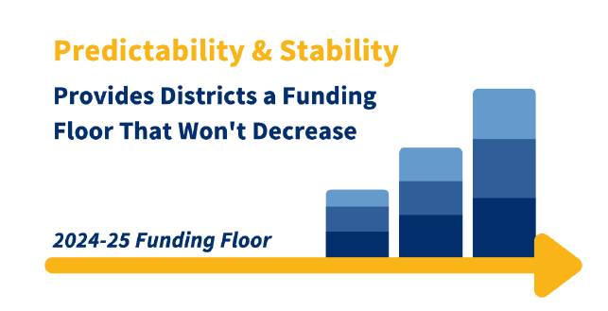
2025-26 State Budget – Funding Floor (Modified Hold Harmless)
Beginning in 2025-26, the new funding floor takes effect, with districts earning either their SCFF generated amount for the year or their “floor" amount, whichever is higher.
This is intended to avoid sharp fiscal declines in 2025-26 and support a smooth transition to the SCFF formula over time.
COLA is not provided on top of the funding floor amount, as was the case during the years of the hold harmless provision which ended in 2024-25.

Slide 15
COLA – History & Forecast
COLA History |  |  | COLA Forecast
2017-18 | 1.56% |  | 2026-27 | 3.02%
2018-19 | 2.71% |  | 2027-28 | 3.42%
2019-20 | 3.26% |  | 2028-29 | 3.31%
2020-21 | 0%
2021-22 | 5.07%
2022-23 | 6.56%
2023-24 | 8.22%
2024-25 | 1.07%
2025-26 | 2.30%
Inflation, supply chain issues, and non-traditional spending levels resulted in uncommonly large COLAs.

Slide 16
State Center CCD

Slide 17
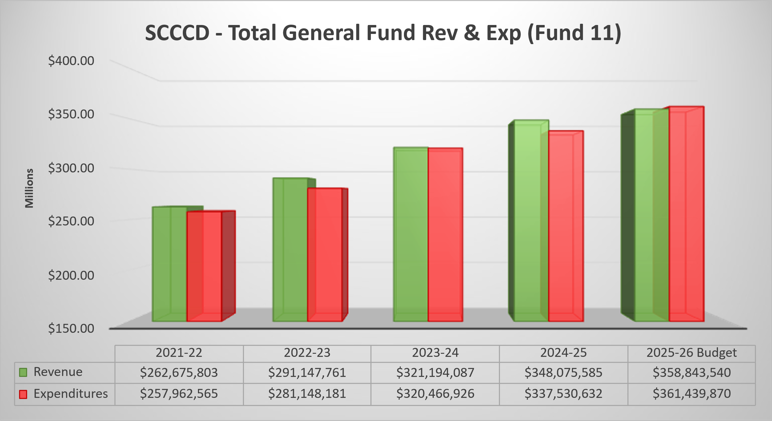
General Fund Revenue Trend

Slide 18
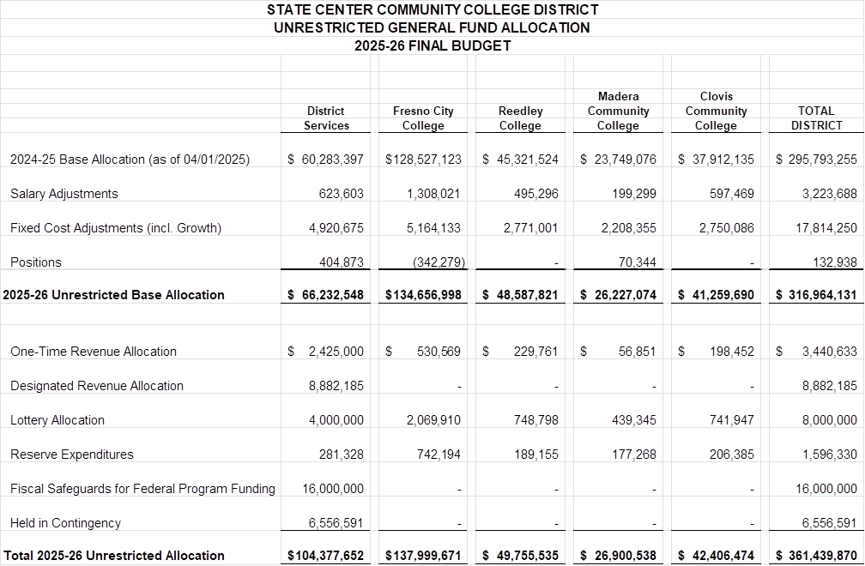
General Fund Allocation

Slide 19
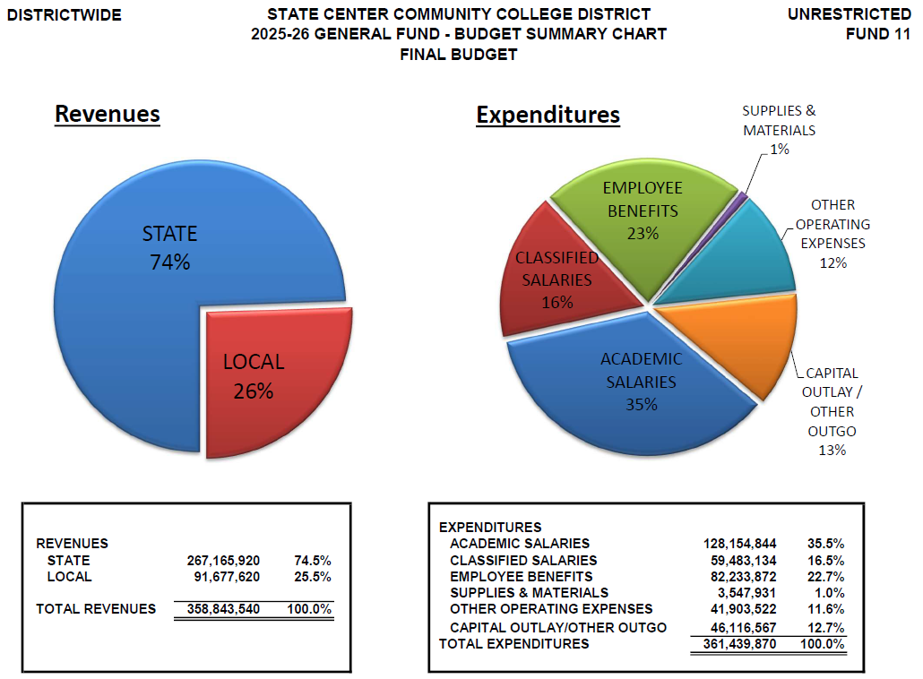
Budget Summary

Slide 20
SCCCD Major Budget Expenditures Adjustments
Major Budget Expenditures Adjustments |  | Tentative Budget (in Millions) | Final Budget (in Millions)
Salary Table Increase (COLA 2.3%) – Classified Only, existing CBA | $ | 0.00 | 1.20
Step and Column | $ | 3.14 | 3.14
Retirement Savings | $ | (1.38) | (1.38)
Fixed Cost Adjustment (Operational/Utility/Insurance/Legal) | $ | 1.53 | 3.08
Growth Funding Allocation | $ | 0.00 | 14.74
** Fiscal Safeguards for Federal Program Funding | $ | 0.00 | 16.00
** Prior Year Rollover/Reserves (OER, PT Faculty Office Hours, Equip POs, Lottery) | $ | 1.00 | 2.60
** Part-time Faculty Health (Pilot Program) | $ | 1.75 | 1.75
*** Held in Contingency (Educational Programs, Capital Projects, Technology, Security, Staffing, Operations & Negotiations) | $ | 4.53 | 6.56
Ongoing
One-Time
Variable

Slide 21
Allocation of 2.35% Growth Funding
 | FTES FUNDS | BASE FUNDS | TOTAL ALLOCATION
FCC | $ 3,627,808 | $ 1,500,000 | $ 5,127,808
RC | $ 1,231,001 | $ 1,500,000 | $ 2,731,001
MCC | $ 668,335 | $ 1,500,000 | $ 2,168,355
CCC | $ 1,210,086 | $ 1,500,000 | $ 2,710,086
DO | — | $ 2,000,000 | $ 2,000,000
 |  |  | $ 14,737,250
Growth funds of $14,737,250 are ongoing funds allocated in the amounts listed.
Colleges and district office will utilize existing processes to prioritize and recommend new positions and expenditures that, in aggregate, are within overall adherence to the 50% law.
Campus processes make recommendations to the college president. Once finalized, the presidents bring recommendations to Chancellor’s Cabinet.

Slide 22
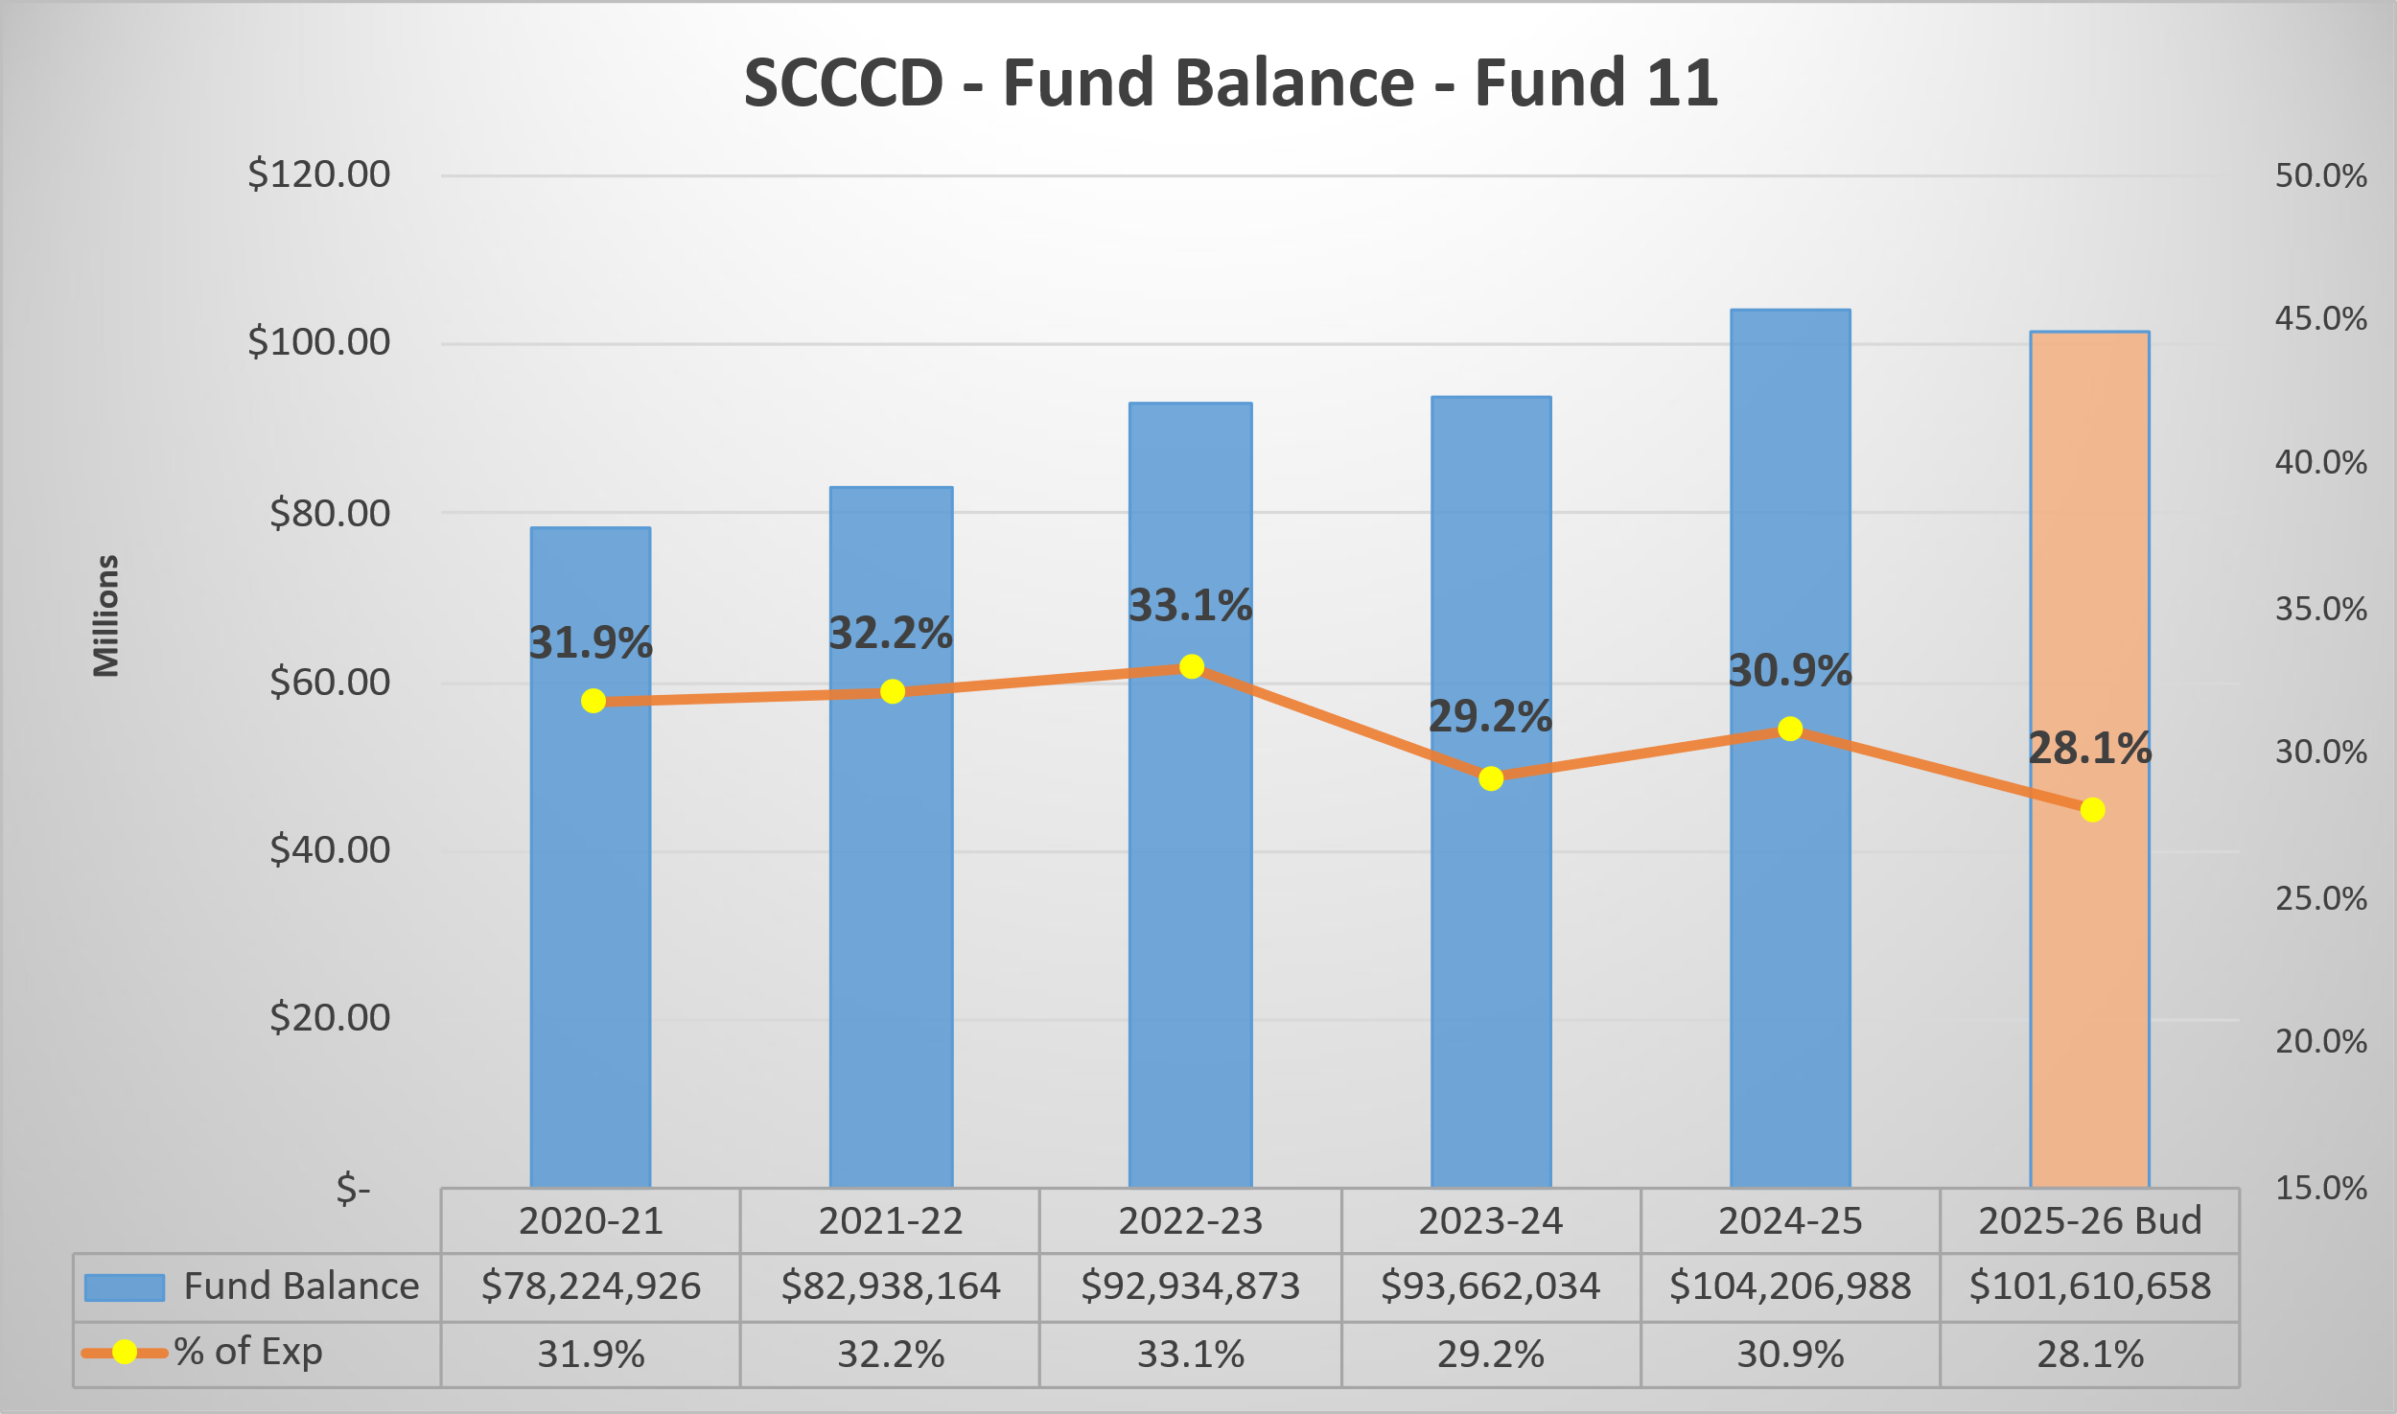
General Fund Balance Trend

Slide 23
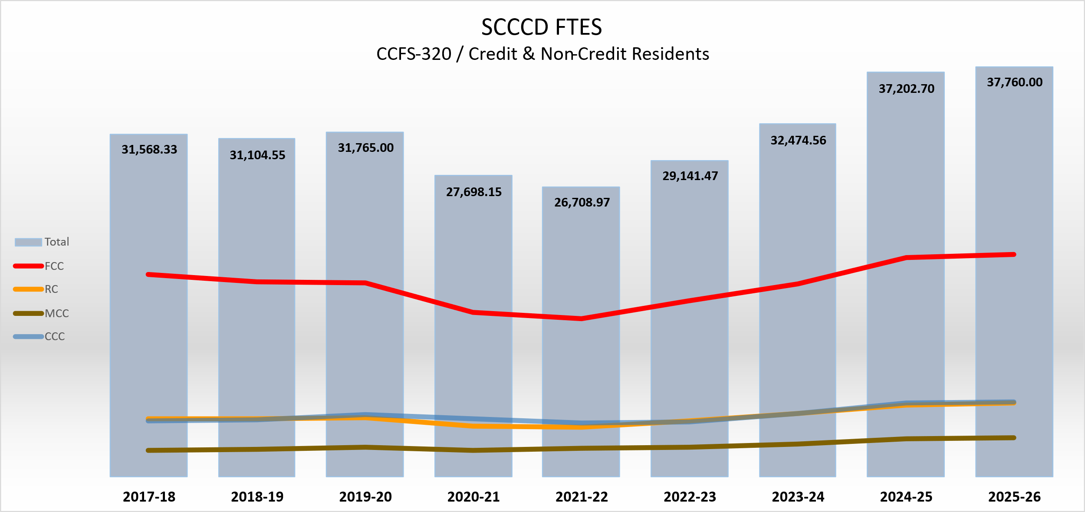
FTES Trend and 2025-26 Targets
Large College
20,187.39

Slide 24
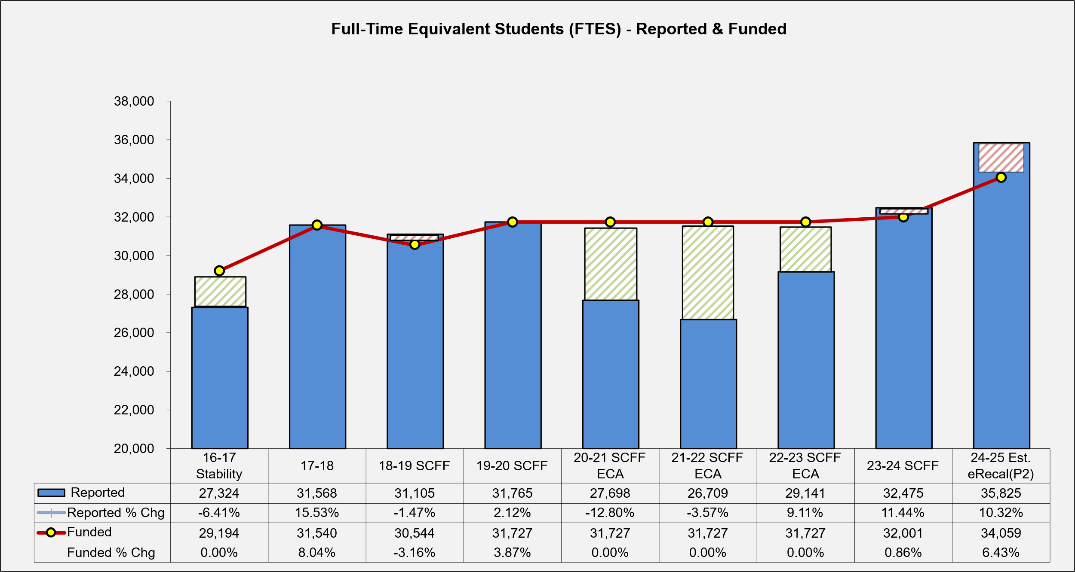
FTES Trend – Reported and Funded

Slide 25
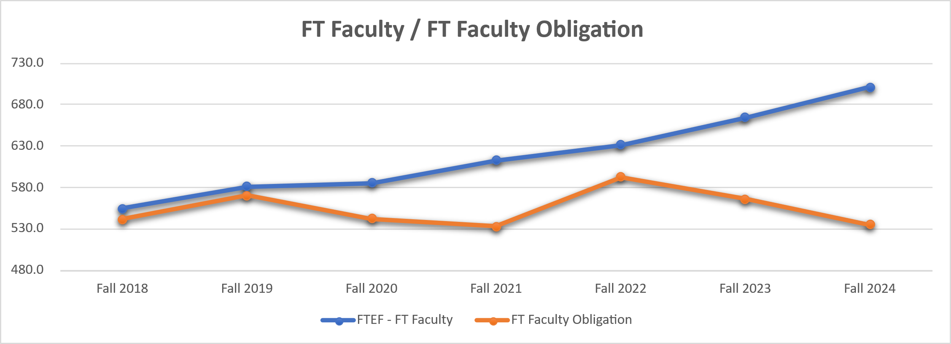
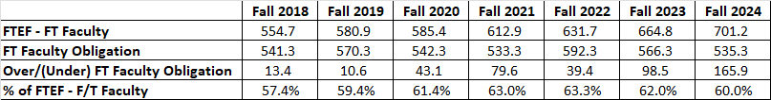
FON Trend

Slide 26
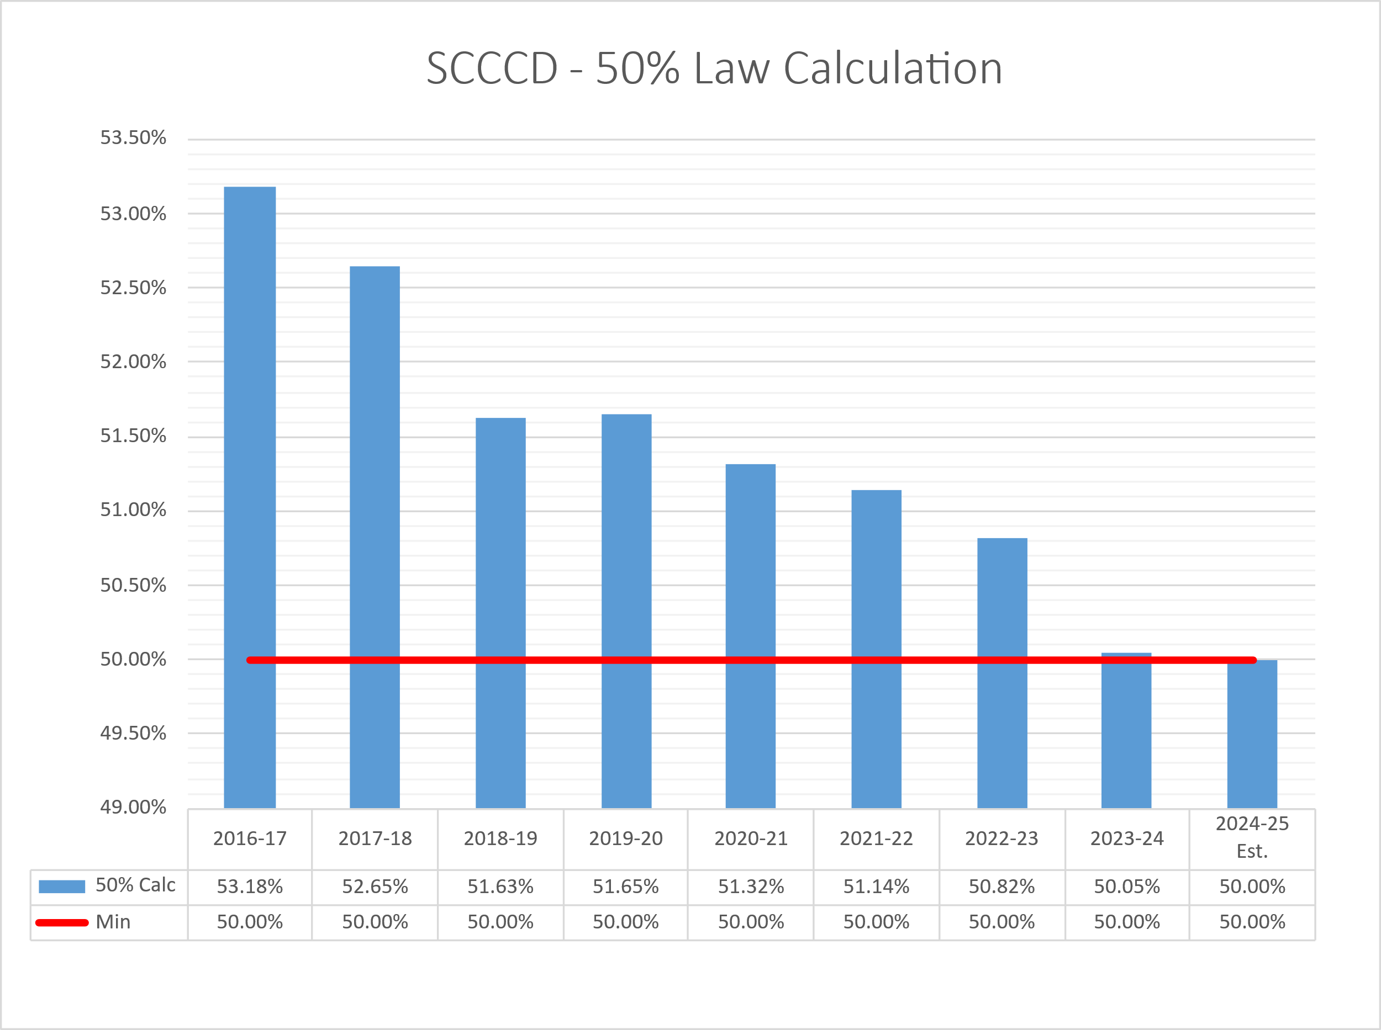
50% Law Trend

Slide 27
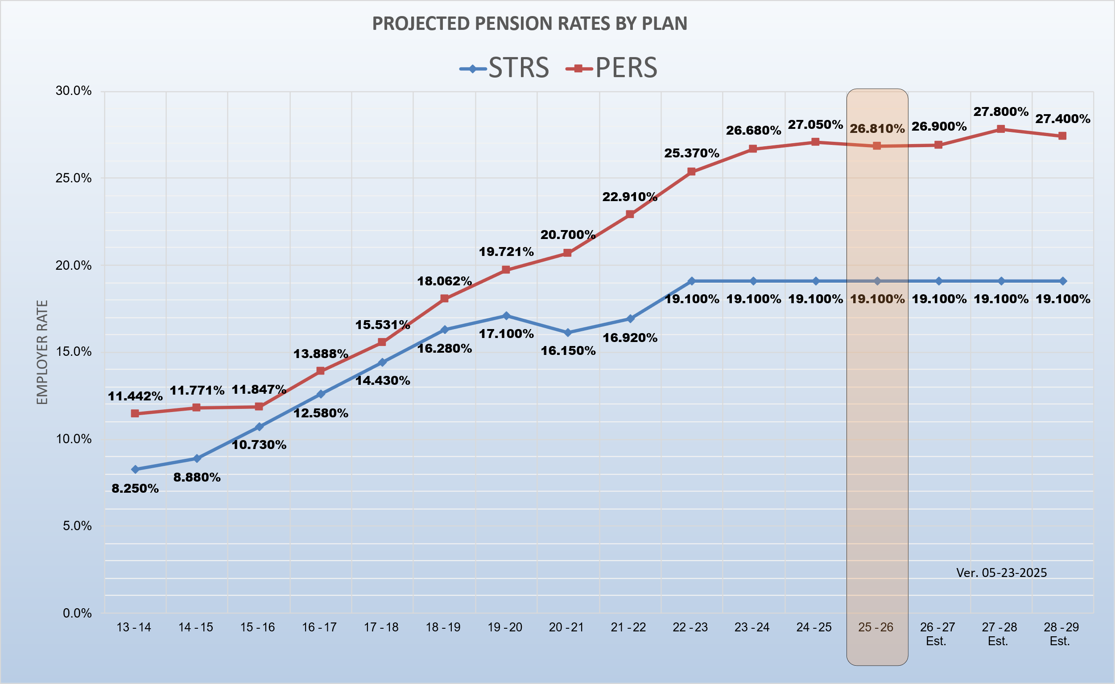
STRS/PERS Rates Trend
STRS Employer Rate:
Starting in 2021–22, the funding plan provided the CalSTRS board limited authority to adjust the employer contribution rate, if necessary, to fully fund the remaining unfunded liability by 2046. Those adjustments are limited to 1% annually, not to exceed 20.25% of creditable compensation.

Slide 28
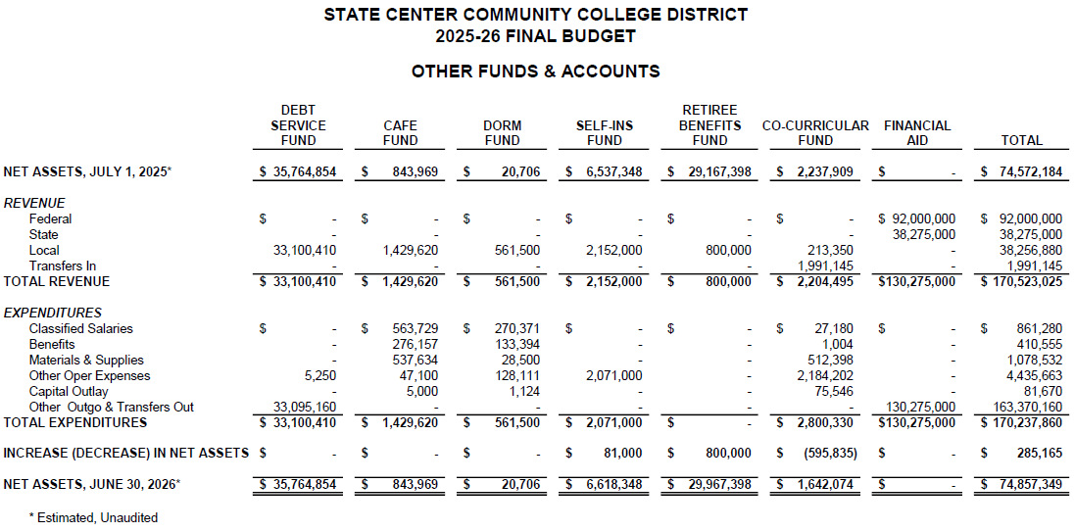
Other Funds

Slide 29
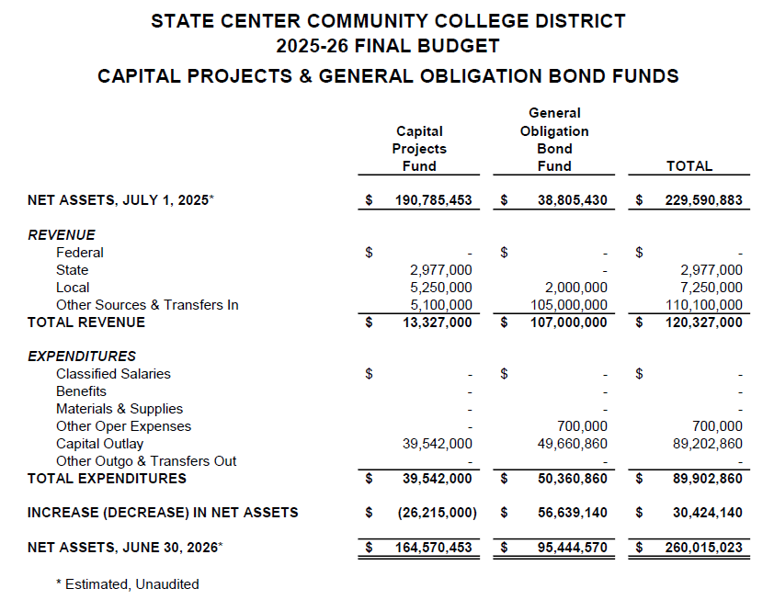
Capital Project Funds

Slide 30
At-a-Glance Summary — California
State of California
Enacted Budget provides budget stability for CCC with substantial COLA and Growth increases, and NO core reductions to programs/services.
Federal policy and geopolitical environments create ongoing uncertainty.
Long-term structural downside risks to the state economy and budget continue, such as an aging population, declining migration inflows, net negative migration, lower fertility rates, ongoing stock market volatility, high housing and living costs, homelessness, and more.
Any necessary future deficit reduction strategies might impose untimely negative impacts on CCC.

Slide 31
At-a-Glance Summary — State Center CCD
State Center CCD
Enrollment has surpassed pre-pandemic levels and remains strong.
Maintains solid fiscal strength in the face of an ambiguous external environment.
Facing challenges with 50% law requirement – an issue at many districts.
Reliant on California for most District funding. Uncertainty around state revenue, deficits, and potential expenditure reductions in the future create planning challenges.
Significant fiscal and societal pressures fueled by the federal administration’s frenzied and disruptive economic and immigration policies create planning and operational challenges.
Budget and operational planning occurs continuously throughout the year. Staff districtwide remain vigilant for challenges and opportunities that might appear on the horizon.

Slide 32
Resources
Chancellor’s Office Budget Resources: Chancellor's Office - Budget News (Joint Analysis) State of California Department of Finance: 2025-26 Enacted Budget

Slide 33
Questions?

